Slide 1


New Business Barometer 2020
jfdi/Opinium
April 2021
Notes:
JG

Slide 2
The largest survey of new business professionals in UK agencies
Notes:
JG

Slide 3
How we did it
Introducing the respondents behind the largest survey of the new business community in the UK
Notes:
JG

Slide 4
Our fieldwork was conducted over three months at the beginning of this year
How we did it
2017: March-September
2018: July-December
2019: September-December
2020: January-March 2021
Notes:
JG

Slide 5
This year’s survey had a slightly smaller pool of respondents compared to previous years
How we did it
2021: 74 new business respondents
Notes:
JG

Slide 6
Most respondents were senior, and covered all agency sizes
How we did it
Respondents by job title
Respondents by agency size
11
63
46
22
6
Manager
Senior Mgr/Director
<50 people
50-150
>150 people
D3 Seniority: D4 How many staff does your agency employ?
Base: all respondents (2020 – 74 new business directors)
Notes:
JG

Slide 7
How we did it
Our sample covered a range of different agency sectors and disciplines
D5 Whilst recognising that agencies are increasingly multi-disciplinary, what would you consider to be your agency’s core business expertise? (Please select up to five answers)
Base: all respondents (2020 – 74 new business directors)
Notes:
JG

Slide 8
Preparing for new business
Who is responsible, what do they do, and how
Notes:
JG

Slide 9
Preparing for new business
As we would expect, new business is led by CEO and MDs in smaller agencies
Q8 Who leads new business in your agency?
Base: all respondents (74 new business directors, 46 Small, 22 Medium and 6 Large agencies)
Notes:
JG

Slide 10
Preparing for new business
And small agencies tend to have very few people dedicated to new business
Q8 Who leads new business in your agency? Q9 How many people are 100% dedicated to the new business and marketing function?
Base: all respondents (74 new business directors, 46 Small, 22 Medium and 6 Large agencies)
Notes:
JG

Slide 11
Preparing for new business
All agencies have had their revenue targets reduced during 2020
-52%
-12%
-19%
Q1 What is your new business revenue target (£) for the next 12 months?
Base: all respondents (2017 -- 94 new business directors, 2018 – 84 new business directors, 2019 – 126 new business directors, 2020 – 74 new business directors)
Notes:
JG

Slide 12
Preparing for new business
New business targets in more detail
New business revenue targets for next 12 months, by agency size
Under £100k
£101-200k
£201-500k
£501k-1m
£1-2m
£2-3m
£3-5m
£5-10m
£10m+
Small
45%
Medium
Large
Q1 What is your new business revenue target (£) for the next 12 months?
Base: all respondents (74 new business directors, 46 Small, 22 Medium and 6 Large agencies)
Notes:
JG

Slide 13
Preparing for new business
Medium agencies have continued to invest heavily in marketing through the Covid-19 period
-1%
+50%
-11%
Question: Q6 What budget has been allocated to agency marketing for the next 12 months?
Base: all respondents (2017 -- 94 new business directors, 2018 – 84 new business directors, 2019 – 126 new business directors, 2020 – 74 new business directors)
Notes:
JG

Slide 14
Allocated marketing spend for small agencies is far lower than medium and large agencies
Preparing for new business
Allocated marketing spend, by agency size
Less than £50k
£50-100k
£100-250k
£250-500k
£500k+
Under review
I don’t know
Average (£000s)
Small
Medium
Large
Question: Q6 What budget has been allocated to agency marketing for the next 12 months?
Base: all respondents (74 new business directors, 46 Small, 22 Medium and 6 Large agencies)
Notes:
JG

Slide 15
Despite a decrease management connections are still the most important
Preparing for new business
Top three prospecting strategies, last four years
Management network connections
Asking clients for referrals
62% (-14)
40% (-2)
Forming alliances and partnerships
Using intermediaries
45% (+7)
40% (+1)
Group opportunities in agency network
Using lead generation agencies
29% (-6)
26% (-2)
Q4 What are your top 3 prospecting strategies? (Please select up to three answers)
Base: all respondents (2017 -- 94 new business directors, 2018 – 84 new business directors, 2019 – 126 new business directors, 2020 – 74 new business directors)
Notes:
JA

Slide 16
But how does that fall out by agency size?
Preparing for new business
Prospecting strategies by agency size
Medium
Small
Large
Management network connections
Forming alliances and partnerships
Using Intermediaries
Asking clients for referrals
Group opportunities in agency network
Using lead generation agencies
Large
Small
Medium
Question: Q4 What are your top 3 prospecting strategies? (Please select up to three answers)
Base: all respondents (74 new business directors, 46 Small, 22 Medium and 6 Large agencies)
Notes:
JA

Slide 17
Small agencies exploit their management & client connections
Preparing for new business
Prospecting strategies by agency size
Medium
Small
Large
Management network connections
Forming alliances and partnerships
Using Intermediaries
Asking clients for referrals
Group opportunities in agency network
Using lead generation agencies
Large
Small
Medium
Question: Q4 What are your top 3 prospecting strategies? (Please select up to three answers)
Base: all respondents (74 new business directors, 46 Small, 22 Medium and 6 Large agencies)
Notes:
JA

Slide 18
But medium agencies are more likely to use intermediaries…
Preparing for new business
Prospecting strategies by agency size
Medium
Small
Large
Management network connections
Forming alliances and partnerships
Using Intermediaries
Asking clients for referrals
Group opportunities in agency network
Using lead generation agencies
Large
Small
Medium
Question: Q4 What are your top 3 prospecting strategies? (Please select up to three answers)
Base: all respondents (74 new business directors, 46 Small, 22 Medium and 6 Large agencies)
Notes:
JA

Slide 19
Large agencies are taking advantage of being able to leverage group opportunities
Preparing for new business
Prospecting strategies by agency size
Medium
Small
Large
Management network connections
Forming alliances and partnerships
Using Intermediaries
Asking clients for referrals
Group opportunities in agency network
Using lead generation agencies
Large
Small
Medium
Question: Q4 What are your top 3 prospecting strategies? (Please select up to three answers)
Base: all respondents (74 new business directors, 46 Small, 22 Medium and 6 Large agencies)
Notes:
JA

Slide 20
Medium and large agencies are actively pursuing more opportunities
Making it happen
+59%
+45%
+1%
Question: Q10 How many new business opportunities have you actively pursued in the past 12 months?
Base: all respondents (2017 -- 94 new business directors, 2018 – 84 new business directors, 2019 – 126 new business directors, 2020 - 74 new business directors, 46 Small, 22 Medium and 6 Large agencies)
Notes:
JG

Slide 21
True to form, the larger the agency the more opportunities actively pursued
Making it happen
Number of opportunities actively pursued in last 12 months, by agency size
None
1-10
11-20
21-30
31-40
41-50
51-60
60+
Average
Small
24
24
Medium
31
45
39
Large
62
Question: Q10 How many new business opportunities have you actively pursued in the past 12 months?
Base: all respondents (74 new business directors, 46 Small, 22 Medium and 6 Large agencies)
21
Notes:
JG

Slide 22
The value of large agency opportunities has increased, while medium and small opportunity values fall
Making it happen
+32%
-9%
-23%
Question: Q11 What was the estimated total value of your new business opportunities?
Base: all respondents (2017 -- 94 new business directors, 2018 – 84 new business directors, 2019 – 126 new business directors, 2020 - 74 new business directors, 46 Small, 22 Medium and 6 Large agencies)
Notes:
JG

Slide 23
What are agencies top priorities for new business and how have these changed?
Making it happen
Top priorities for new business performance, by agency size, past 4 years
2019
2019
2020
2018
2020
2019
2018
2018
2018
2020
2018
2020
2018
2020
2018
2020
2020
2020
2019
2019
2019
2019
2019
2019
2019
2018
2018
2017
2019
2017
2017
2017
2017
2017
2017
2017
2017
2017
2017
2017
Question: Q7 Thinking about your new business performance over the next 12 months, which of the following would be your top priority?
Base: all respondents (2017 -- 94 new business directors, 44 Small, 22 Medium, 28 Large; 2018 – 84 new business directors, 39 Small, 22 Medium, 23 Large; 2019 – 126 new business directors, 68 Small, 32 Medium and 26 Large agencies; 2020 – 74 new business directors, 46 Small, 22 Medium, 6 Large)
Notes:
JG

Slide 24
Small agencies are getting invited to pitch in 38% of opportunities they pursue
Converting the opportunities
Opportunities pursued, invites to pitches and pitches won by agency size
Small
c
c
Medium
Large
Opps pursued
Pitches
Pitch wins
Opps pursued
Pitches
Pitch wins
Opps pursued
Pitches
Pitch wins
Conversion rate
Conversion rate
Conversion rate
Opps to pitch
Pitch to win
Opps to pitch
Pitch to win
Opps to pitch
Pitch to win
24
Question: Q10 How many new business opportunities have you actively pursued in the past 12 months? Q12 What percentage of these new business opportunities resulted in pitches requested by the client? Q13 What percentage of these pitches did you win (conversion rate) over the past 12 months?
Base: all respondents (74 new business directors, 46 Small, 22 Medium and 6 Large agencies)
Notes:
JG

Slide 25
Medium agencies are getting invited to pitch at a higher rate than small businesses
Converting the opportunities
Opportunities pursued, invites to pitches and pitches won by agency size
Small
c
c
Medium
Large
Opps pursued
Pitches
Pitch wins
Opps pursued
Pitches
Pitch wins
Opps pursued
Pitches
Pitch wins
Conversion rate
Conversion rate
Conversion rate
Opps to pitch
Pitch to win
Opps to pitch
Pitch to win
Opps to pitch
Pitch to win
25
Question: Q10 How many new business opportunities have you actively pursued in the past 12 months? Q12 What percentage of these new business opportunities resulted in pitches requested by the client? Q13 What percentage of these pitches did you win (conversion rate) over the past 12 months?
Base: all respondents (74 new business directors, 46 Small, 22 Medium and 6 Large agencies)
Notes:
JG

Slide 26
And large agencies have the best conversion from opportunity to pitch at 50%
Converting the opportunities
Opportunities pursued, invites to pitches and pitches won by agency size
Small
c
Medium
Large
Opps pursued
Pitches
Pitch wins
Opps pursued
Pitches
Pitch wins
Opps pursued
Pitches
Pitch wins
Conversion rate
Conversion rate
Conversion rate
Opps to pitch
Pitch to win
Opps to pitch
Pitch to win
Opps to pitch
Pitch to win
26
Question: Q10 How many new business opportunities have you actively pursued in the past 12 months? Q12 What percentage of these new business opportunities resulted in pitches requested by the client? Q13 What percentage of these pitches did you win (conversion rate) over the past 12 months?
Base: all respondents (74 new business directors, 46 Small, 22 Medium and 6 Large agencies)
Notes:
JG

Slide 27
All Agencies have got through to pitch stage more often than in 2019
Converting the opportunities
27
Questions: Q12 What percentage of these new business opportunities resulted in pitches requested by the client? Q13 What percentage of these pitches did you win (conversion rate) over the past 12 months?
Base: all respondents (2017 -- 94 new business directors, 2018 – 84 new business directors, 2019 – 126 new business directors, , 2020 – 74 new business directors)
Notes:
JG

Slide 28
And conversion from pitch to win are also increasing for large and medium
Converting the opportunities
28
Questions: Q12 What percentage of these new business opportunities resulted in pitches requested by the client? Q13 What percentage of these pitches did you win (conversion rate) over the past 12 months?
Base: all respondents (2017 -- 94 new business directors, 2018 – 84 new business directors, 2019 – 126 new business directors, 2020 – 74 new business directors)
Notes:
JG

Slide 29
There have been some changes in the value of opportunities won
Converting the opportunities
Value of pitches won in last 12 months, by agency size, last four years
Under £100k
£101-500k
£500k-£1m
£1-£5m
£5m+
Small
2018
2020
2018
2020
2017
2019
2017
2019
Medium
Large
Question: Q14 What was the total value of the pitches that you’ve won over the past 12 months?
Base: all respondents (2017 -- 94 new business directors, 44 Small, 22 Medium, 28 Large; 2018 – 84 new business directors, 39 Small, 22 Medium, 23 Large; 2019 – 126 new business directors, 68 Small, 32 Medium and 26 Large agencies, 2020 - 74 new business directors, 46 Small, 22 Medium and 6 Large agencies)
29
Notes:
JG

Slide 30
And this can be seen when we look at the average values too
Converting the opportunities
Value of opportunities pursued lost and won (000s), by agency size, last four years
Small
Medium
Large
Lost
Lost
Won
Lost
Won
Won
Questions: Q11 What was the estimated total value of your New Business Opportunities? Q14 What was the total value of the pitches that you’ve won over the past 12 months?
Base: all respondents (2017 -- 94 new business directors, 2018 – 84 new business directors, 2019 – 126 new business directors, 2020 – 74 new business directors)
30
Notes:
JG

Slide 31
In a fifth of cases agencies are rarely given reasons
Challenges and opportunities
Question: Q16 For those pitches you have lost, what are the most common reasons given by clients for not awarding your agency the business?
Base: all respondents 2020 – 74 new business directors)
Notes:
JG

Slide 32
Getting attention and turning this into pitches are the biggest new biz challenges during lockdown times
Challenges and opportunities
Adapting the new business process to Covid-19
Very difficult
Difficult
Easy
Very easy
32
Q21. Finally, we'd like to ask about your agency's experience of new business during the coronavirus/Covid-19 pandemic and related lockdowns. How easy or difficult has it been for your agency to successfully adapt to the following related to managing the new business process? Base: all respondents 2020 – 74 new business directors)

Slide 33
But specifically on the pitch process creating chemistry over video calls is by far the biggest difficulty
Challenges and opportunities
Adapting the new pitch process to Covid-19
Very difficult
Difficult
Easy
Very easy
33
Q22. And how easy or difficult during the coronavirus/Covid-19 pandemic has it been for your agency to successfully adapt to the following related to managing the pitch process? Base: all respondents 2020 – 74 new business directors)

Slide 34
Appendix: about jfdi and Opinium

Slide 35

About jfdi
jfdi is the leading specialist new business consultancy that works exclusively with agencies, and only agencies, across the marketing services sectors.
jfdi has worked with over 500 agencies to win more new business by filling pipelines, converting pitches and growing existing clients.
They do this via training, consultancy, coaching and providing hands-on, senior new business directors if needed
For more information please contact:
Mark@jfdi.uk.com or call 07711 729319

Slide 36
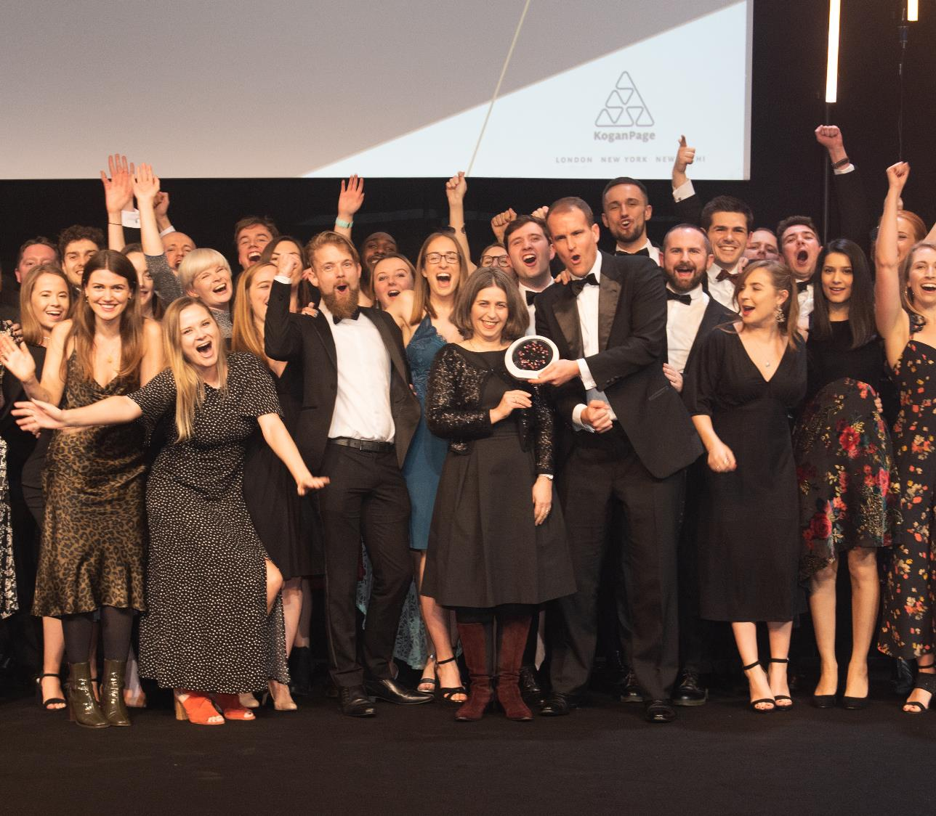
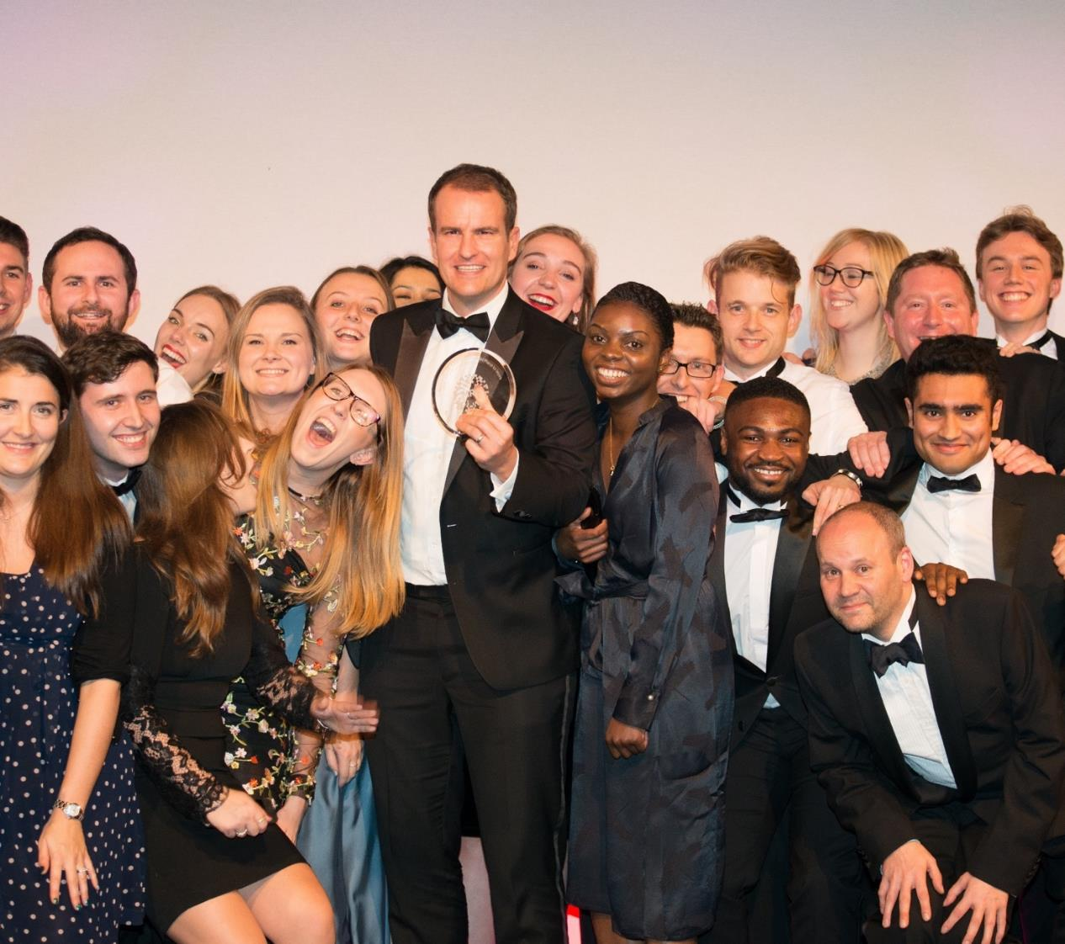
About Opinium
For the fourth year in a row Opinium are delighted to partner jfdi for the New Business Barometer 2020.
Opinium is an award winning strategic insight agency built on the belief that in a world of uncertainty and complexity, success depends on the ability to stay on the pulse of what people think, feel and do. Creative and inquisitive, we are passionate about empowering our clients to make the decisions that matter.
We help our clients harness the power of insight to build,
grow, promote and make strategic business decisions.
For more information please contact:
research@opinium.co.uk or call 020 7566 3190

Slide 37




Mark Clark
Managing Director, jfdi
Josh Glendinning
Associate Director, Opinium
07711 729319
+44 (0)20 3119 3684
MARK@JFDI.UK.COM
JOSHGLENDINNING@opinium.co.uk

